Slide 1

AIRLINE ANALYSIS
SIDDIRAJU PRERANA
PGDDM43

Slide 2
Agenda
1
2
3
4
5
Introduction to Data Analysis
Data collection and Cleaning
Visualization Techniques
Problem Statement
Modules imported

Slide 3
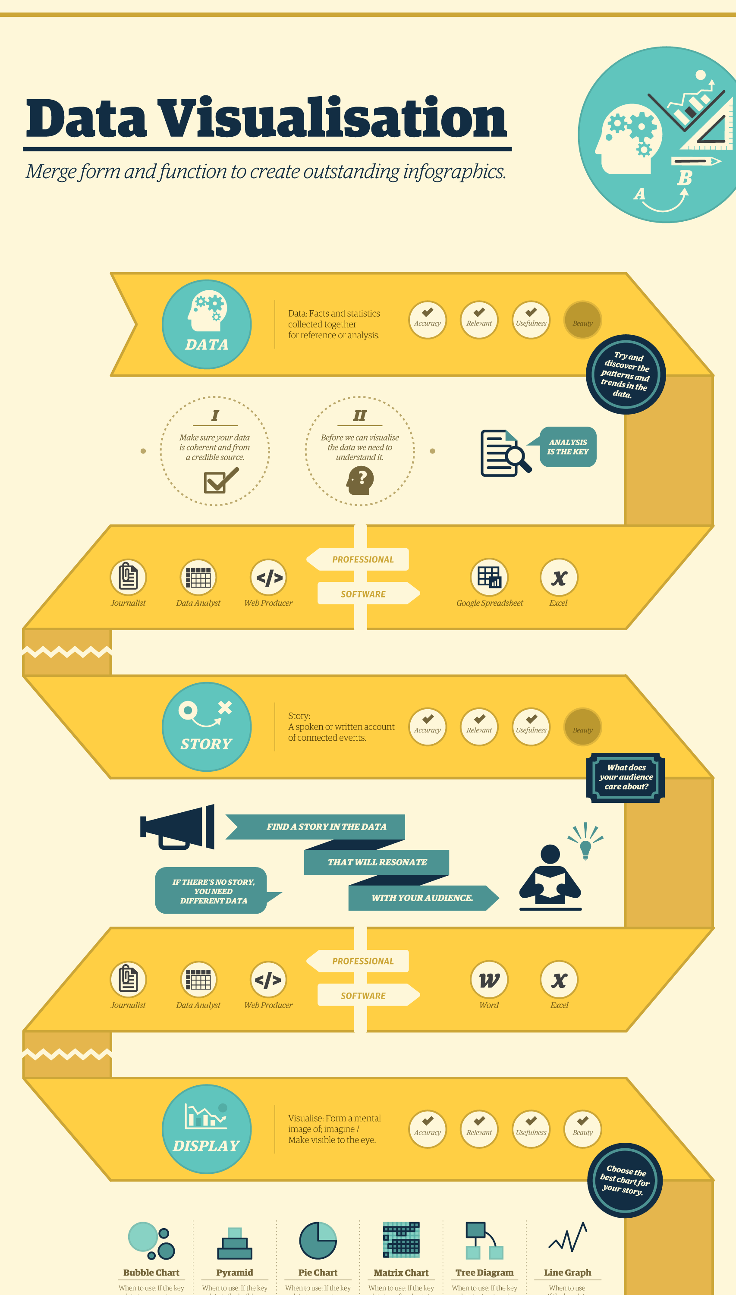
INTRODUCTION TO DATA ANALYSIS
Data analysis is the process of examining, cleaning, transforming, and modeling data with the goal of discovering useful information, drawing conclusions, and supporting decision-making.
It involves applying various statistical, computational, and visual techniques to understand and interpret data in meaningful ways.

Slide 4
Data Collection and Cleaning

Slide 5
Data Collection
Data Collection is the first step in the data analysis process.
It involves gathering raw data from various sources like surveys, sensors, databases, or online platforms to address specific questions or solve problems.
Gathering Relevant Data: Data collection in DAV involves systematically gathering data from various sources such as databases, APIs, surveys, or sensors. The goal is to ensure that the data collected is relevant, accurate, and sufficient for the analysis. The quality of the collected data directly impacts the insights and conclusions drawn during the analysis and visualization phases.

Slide 6
Data Cleaning
Removing Inconsistencies and Errors: Data cleaning involves identifying and correcting errors or inconsistencies in the dataset, such as duplicates, missing values, or incorrect data entries. This process is essential to ensure that the data is accurate and reliable, which directly impacts the quality of the analysis and the validity of the visualizations created.
Standardizing Data Formats: During data cleaning, it's important to standardize the data formats to ensure uniformity across the dataset. This includes converting dates, times, and other values to a consistent format, ensuring that categories are uniformly labeled, and normalizing numerical data where necessary. Standardization simplifies the analysis process and enhances the clarity and effectiveness of visualizations.

Slide 7
VISUALIZATION TECHNIQUES
“
A visualization technique is a method used to represent data graphically, making complex information easier to understand and interpret.
It involves the use of charts, graphs, maps, and other visual tools to highlight patterns, trends, and relationships within the data. By transforming raw data into visual formats, these techniques help users quickly grasp insights
”

Slide 8
Problem Statements
Understanding Passenger Satisfaction: Analyze the relationship between various factors such as in-flight services, online boarding experience, and customer demographics on overall passenger satisfaction. Identify key drivers of satisfaction to improve service quality and enhance customer experience.
Predictive Modeling for Service Improvement: Develop predictive models to forecast passenger satisfaction levels based on historical data. Utilize these models to recommend targeted improvements in specific areas like online boarding, seat comfort, and type of travel, ultimately aiming to increase overall customer satisfaction and loyalty.

Slide 9
Imported Modules
pandas (import pandas as pd):
Usage: You can use pandas to load datasets, clean and preprocess data, perform aggregations, filter and slice data, and much more.
numpy (import numpy as np):
Usage: numpy is often used for performing element-wise operations, generating random numbers, or handling arrays and matrices in a computationally efficient way.
seaborn (import seaborn as sns):
Usage: seaborn is commonly used to create plots like histograms, bar charts, scatter plots, and heatmaps. It also has built-in themes and color palettes that make it easier to create visually appealing plots.

Slide 10
Imported Modules(cont..)
seaborn (import seaborn as sns):
Usage: seaborn is commonly used to create plots like histograms, bar charts, scatter plots, and heatmaps. It also has built-in themes and color palettes that make it easier to create visually appealing plots.
matplotlib.pyplot (import matplotlib.pyplot as plt):
CSV:
A CSV (Comma-Separated Values) file is a simple, text-based format used to store tabular data where each line represents a row, and columns are separated by commas.
Usage: matplotlib.pyplot is often used to customize plots created with seaborn or to create custom visualizations from scratch. It allows you to control various aspects of the plot, such as titles, labels, legends, and axes.

Slide 11
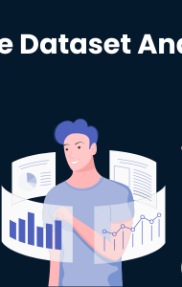
Analyzing Dataset
The code provided performs an analysis of a dataset by creating a correlation heatmap. This heatmap visually represents the strength and direction of relationships between different numerical features in the dataset. By computing the correlation matrix using pandas, the code identifies how closely related the variables are, with correlations ranging from -1 (perfect negative correlation) to 1 (perfect positive correlation). The heatmap, generated using seaborn, provides an intuitive way to identify patterns, such as strong correlations or potential multicollinearity between features, which can be critical for understanding the underlying structure of the data and informing further analysis or modeling efforts.

Slide 12
Conclusion
In conclusion, the correlation heatmap generated from the dataset provides valuable insights into the relationships between various numerical features. By visually highlighting the strength and direction of correlations, the heatmap allows us to quickly identify which variables are closely related and which are not. This analysis is crucial for detecting potential multicollinearity issues, guiding feature selection, and understanding the interplay between variables, ultimately supporting more informed decision-making and improving the effectiveness of subsequent data modeling and analysis efforts.

Slide 13


